Slide 1
Solar controller PLC
June Patrick Dacaya

Slide 2
Project background
Create a responsive mobile app GUI as well as a prototype solar panel system that will be controlled, monitored, and updated.
Main functions: Control the solar panel’s position and also gather data such as power harvest, average harvest for the last half hour. I also wanted to store the solar panels position on earth.
Apply and develop Programmable Logic Controller functionalities and concept

Slide 3
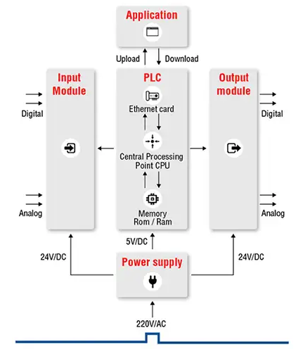
PLC Architecture

Slide 4
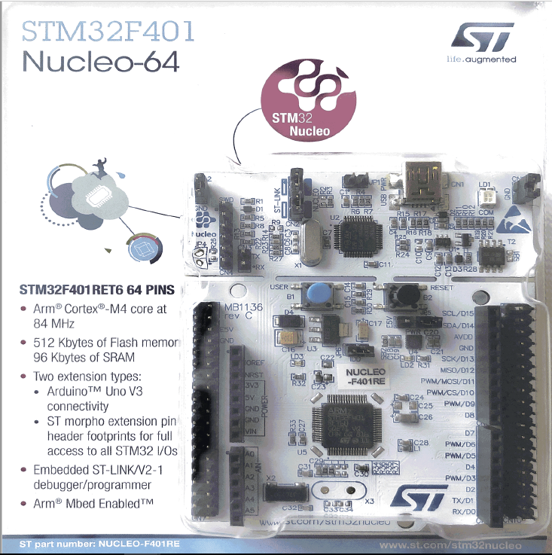
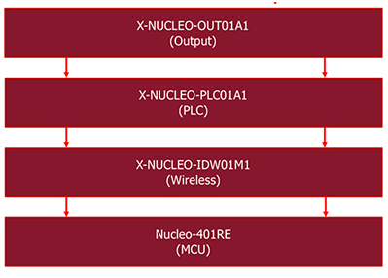
Hardware and components

Slide 5
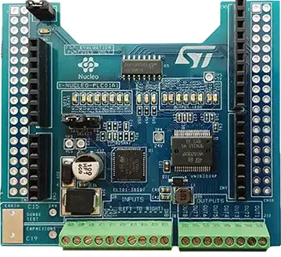
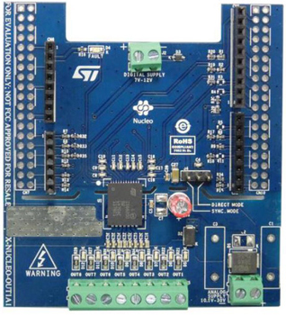
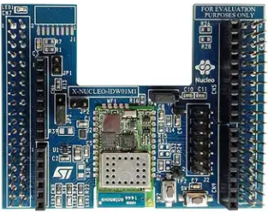
PLC01a1 | out01a1 | idw01m1

Slide 6
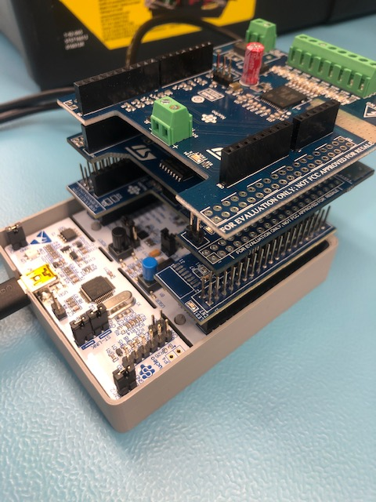
Hardware assembly

Slide 7
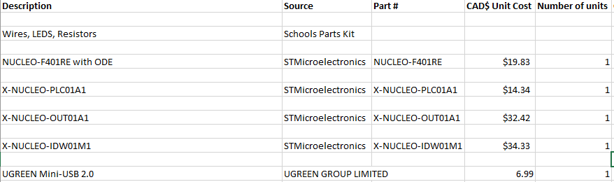
Project budget

Slide 8
Progress
Schedule is almost always followed on time.
Current progress was able to run a simple blinky program into my development flat-form to show that the PLC set is connected and working.
Hardware enclosure not finalized.

Slide 9
Course knowledge from previous courses
Embedded Systems
Technical C
Intro to Software Engineering
Electronic Circuits

Slide 10
Project link
https://github.com/junedacaya/L-wingSolarPanelInteractiveDisplay

